Slide 1
Heart Failure Prediction
Ajit Kolekar
DSC 520 - Final Project
Bellevue University

Slide 2
Problem Statement and Research Questions
Problem Statement: Determine factors that could contribute to the death by heart failure using historical data and to predict how the death by heart failure can be avoided by taking necessary steps.
Research Questions:
What impact does age have on the risk of death due to heart failure?
Does diabetes contribute to death due to heart failure?
How does ejection fraction relate to the heart’s health?
Does high blood pressure contribute to death due to heart failure?
How does serum creatinine relate to the heart’s health?

Slide 3
Description of variables
age - Age of the patient (Numeric value)
diabetes - If the patient has diabetes (Boolean value - 0 for No and 1 for Yes)
ejection_fraction - Percentage of blood leaving the heart at each contraction (Integer value - percentage)
high_blood_pressure - If the patient has hypertension (Boolean value - 0 for No and 1 for Yes)
serum_creatinine - Level of serum creatinine in the blood (Numeric value - mg/dL)
DEATH_EVENT - If the patient deceased during the follow-up period (Boolean value - 0 for No and 1 for Yes)
DEATH_EVENT is the dependent (outcome) variable while all other variables are independent variables.

Slide 4
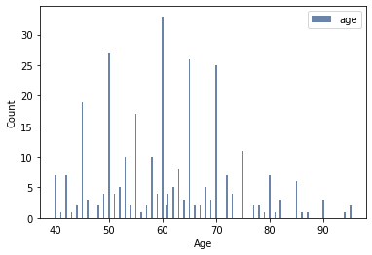
‘age’ Variable Analysis
Mean: 60.83
Mode: 60.00
Median: 60.00
Outliers: None
Range: 40 to 95
Distribution looks to be skewed to the right

Slide 5
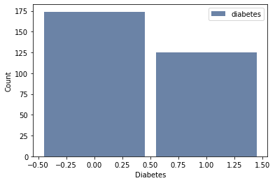
‘diabetes’ Variable Analysis

Slide 6
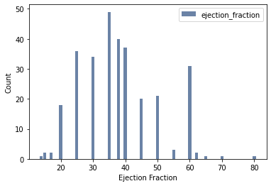
‘ejection_fraction’ Variable Analysis
Mean: 38.08
Mode: 35
Median: 38
Outliers: 80
Range: 14 to 80
Distribution does not look like normal distribution

Slide 7
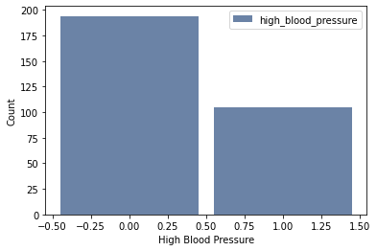
‘high_blood_pressure’ Variable Analysis

Slide 8
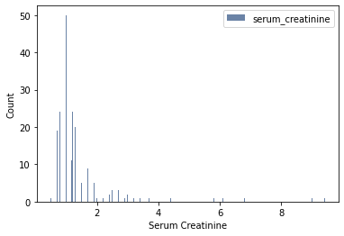
‘serum_creatinine’ Variable Analysis
Mean: 1.39
Mode: 1.0
Median: 1.1
Outliers: 5.0, 5.8, 6.1, 6.8, 9.0, 9.4
Range: 0.5 to 9.4
Distribution looks to be skewed to the right with a long tail

Slide 9
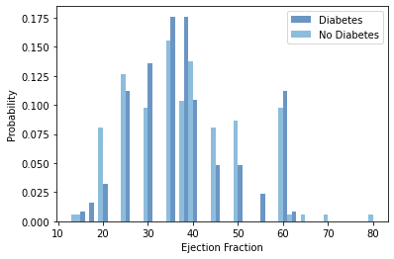
PMF – Diabetes compared to Ejection Fraction
There is no consistent pattern of whether ejection fraction increases or decreases based on whether the patient was diabetic or not
It appears in general that the diabetic patients had lower ejection fraction than non-diabetic patients

Slide 10
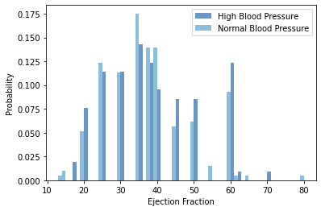
PMF – High Blood Pressure compared to Ejection Fraction
There is no consistent pattern of whether ejection fraction increases or decreases based on whether the patient had high blood pressure or not
It appears in general that the patients with high blood pressure had higher ejection fraction than patients with normal blood pressure

Slide 11
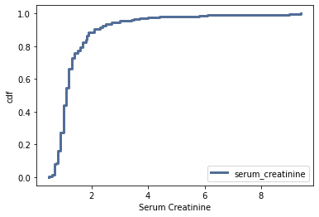
CDF – Serum Creatinine
There is a sudden increase in the Serum Creatinine from 0.8 to 2.0.
Approximately 90% patients fall within that range.
The patients with Serum Creatinine of greater than 2.0 are a small of patients and most of the values are identified as outliers.

Slide 12
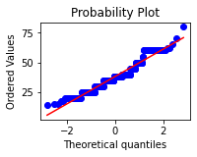
Normal Probability Plot – Ejection Fraction
The plot matches the model near the mean and is consistent through one standard deviation.
The values deviate in the tails.
The distribution is well within a standard deviation from the mean, and not in the tails.

Slide 13
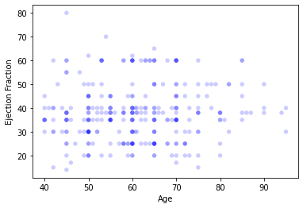
Scatterplot – Age vs Ejection Fraction
By looking at the scatterplot, it indicates that there is no relationship between Age and Ejection Fraction, since the data points are spread all over the plot.
The Correlation Coefficient is 0.06 which indicates that the relationship is not significant.

Slide 14
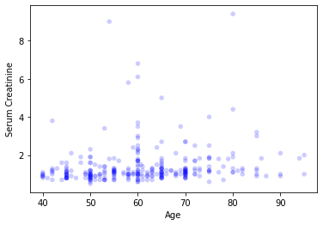
Scatterplot – Age vs Serum Creatinine
By looking at the scatterplot, it indicates that most of the data points are condensed at the bottom left due the number of outliers in Serum Creatinine and due to may patients being young.
The Correlation Coefficient is 0.16 which indicates that the relationship is low positive.

Slide 15
Hypothesis Testing
Conducted hypothesis testing to determine if diabetes contributes to death by heart failure
Null Hypothesis: Diabetes does not contribute to death by heart failure
P Value is 0.926 which indicates that the diabetes variable is not statistically significant, since P value is not less then 0.05
This validates the Null Hypothesis that diabetes does not contribute to death by heart failure

Slide 16
Regression Analysis
Logistic Regression Model
Dependent variable - DEATH_EVENT
Independent variables – age, diabetes, ejection_fraction, high_blood_pressure, serum_creatinine
Variable | Coef | P Value
age | 0.0525 | 0.000
diabetes | 0.2038 | 0.480
ejection_fraction | -0.0711 | 0.000
high_blood_pressure | 0.4370 | 0.138
serum_creatinine | 0.6905 | 0.000

Slide 17
Regression Analysis – Contd.
Based on the P values of the variables, the Logistic Regression Model indicated that
age variable is statistically significant, and it has low positive relationship with DEATH_EVENT
Diabetes variable is not statistically significant
ejection_fraction variable is statistically significant, and it has low negative relationship with DEATH_EVENT
high_blood_pressure variable is not statistically significant
serum_creatinine variable is statistically significant, and it has high positive relationship with DEATH_EVENT

